Slide 1


The Gendered University in
Times of Austerity
Rosemary Deem, Royal Holloway University of London, UK
R.Deem@rhul.ac.uk

Slide 2
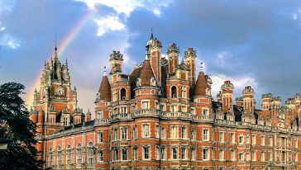
Royal Holloway: founded as Women’s College 1866; joined University of London 1900; became mixed in 1965, merged with Bedford College 1985. Last woman principal was Dorothy Wedderburn from 1985-1990

Slide 3
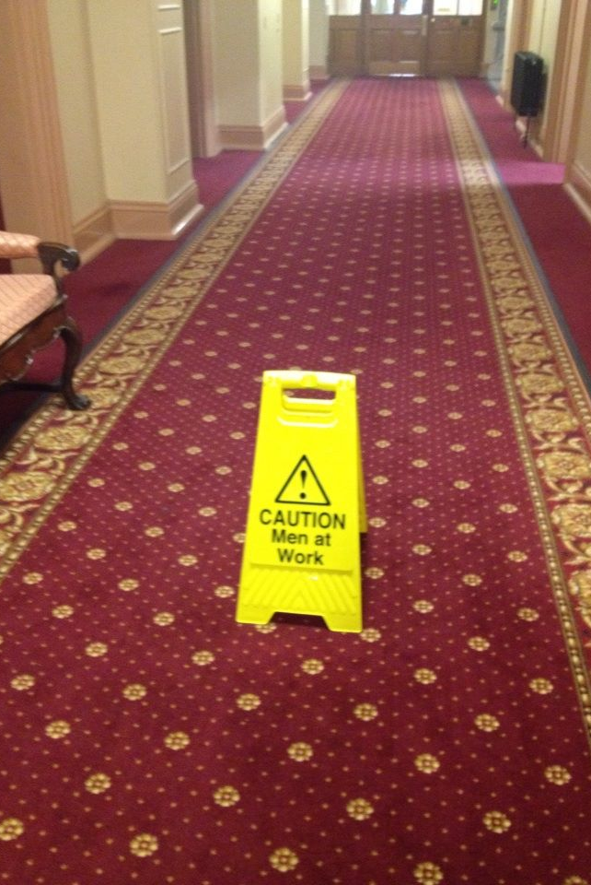
This is the senior team corridor at Royal Holloway
All the women members of the senior team are concentrated at the far end of the corridor furthest away from the Principal. It is claimed this is accidental …
Or maybe men at work is an unusual phenomenon which requires attention to be drawn to it, whereas women at work is an everyday occurrence

Slide 4
Austerity & the university
What is austerity? A working definition is cuts in public spending by governments trying to reduce their deficits
Public universities hard hit by austerity: less/no academic hiring, no/less promotion, higher teaching loads, reduced research funding, students more instrumental & consumerist (Naidoo, Shankar, Ekant 2011)
When money is short, priorities change; why bother with gender equality or social sciences & humanities?
Many universities are New Managerial (Deem, Reed, Hillyard 2007) & increasingly corporate (Bok 2004);are changes in govermance (Bruckman & Caravalho 2012). Everything is measured & monetized, greater emphasis on academic performativity.

Slide 5
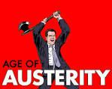
Austerity means spending cuts:
Public services are in the forefront of such cuts

Slide 6
Gender Equality in Higher Education and Complacency
Gender mainstreaming may have reduced the need for gender to have a strong policy presence (Deem 2007), UK HEFCE project 6 institutional case studies of staff equality policies
‘Gender – that’s solved, we have lots of women academics’. But they’re often not in senior roles
There are more women undergraduates than men – so what’s the problem? This ignores what happens prior to and after graduation (David 2014, Visao 2012)
If women are not equal to men it’s a lifestyle choice not discrimination (Howard & Tibballs 2003)

Slide 7
Where are we now?
"I remember we used to say that the inequalities between men and women would disappear once the problem of the level of studies was solved. Education has not solved the problem of inequality,”
Analia Torres, 2012. Quoted in Vox Europe

Slide 8

What does a leader look like?
White, male ….

Slide 9
Why don’t women end up in HE leadership positions?
The ‘careless’ manager (Grummell, Devine & Lynch 2009b)
Male networks & homosociability (Grummell, Devine & Lynch 2009a) act as gatekeepers & choose people like themselves ,
Discrimination in promotion /selection process (van den Brink 2009)
Women all-rounders but research valued most as leadership preparation
HE leaders often from STEM subjects where fewer women
Women may emphasise own barriers ( Caravalho, Machado-Taylor, Özkanli 2012) such as not wanting overseas travel or evening events

Slide 10
Women leaders; how are they viewed?
In our late 1990s study of new managerialism in UK universities, we asked questions about gender of senior teams but women respondents gave answers without being asked the questions …(Deem 2002)
Women & men leaders in higher education do the same job but are confronted by different expectations: women are not expected to be assertive, competitive, clever, argumentative but rather polite, emotional, caring and hard working (Deem 2003)

Slide 11
How to get more women in senior positions
Morley (2012) suggests, following Schiebinger, (1999), that we need to:
Fix the women: provide mentoring, coaching, build confidence and skills, encourage greater assertiveness & risk taking
Fix the organisation: gender mainstreaming; equality policies, processes and practice; challenge discriminatory structures such as promotion criteria, do equality impact assessment of policies, review procedures, flexi -working & work/ life balance schemes .
Fix the knowledge: e.g identify sources of unconscious bias, introduce curriculum change shaped by gender in all disciplines, offer gender studies

Slide 12
Some more radical ideas: Goodall & Osterloh Times Higher 14/5/15
1. Financial rewards if women take on leadership roles
Use job sharing for management roles
Use random selection from equally qualified pool of applicants for middle level manager posts

Slide 13
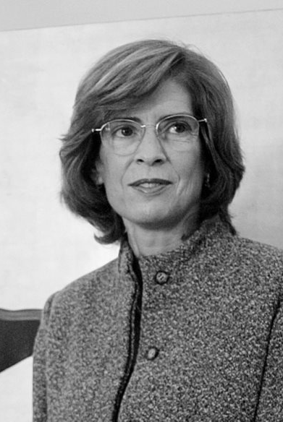
Do you know who this is?
And why it took 48 years?

Slide 14
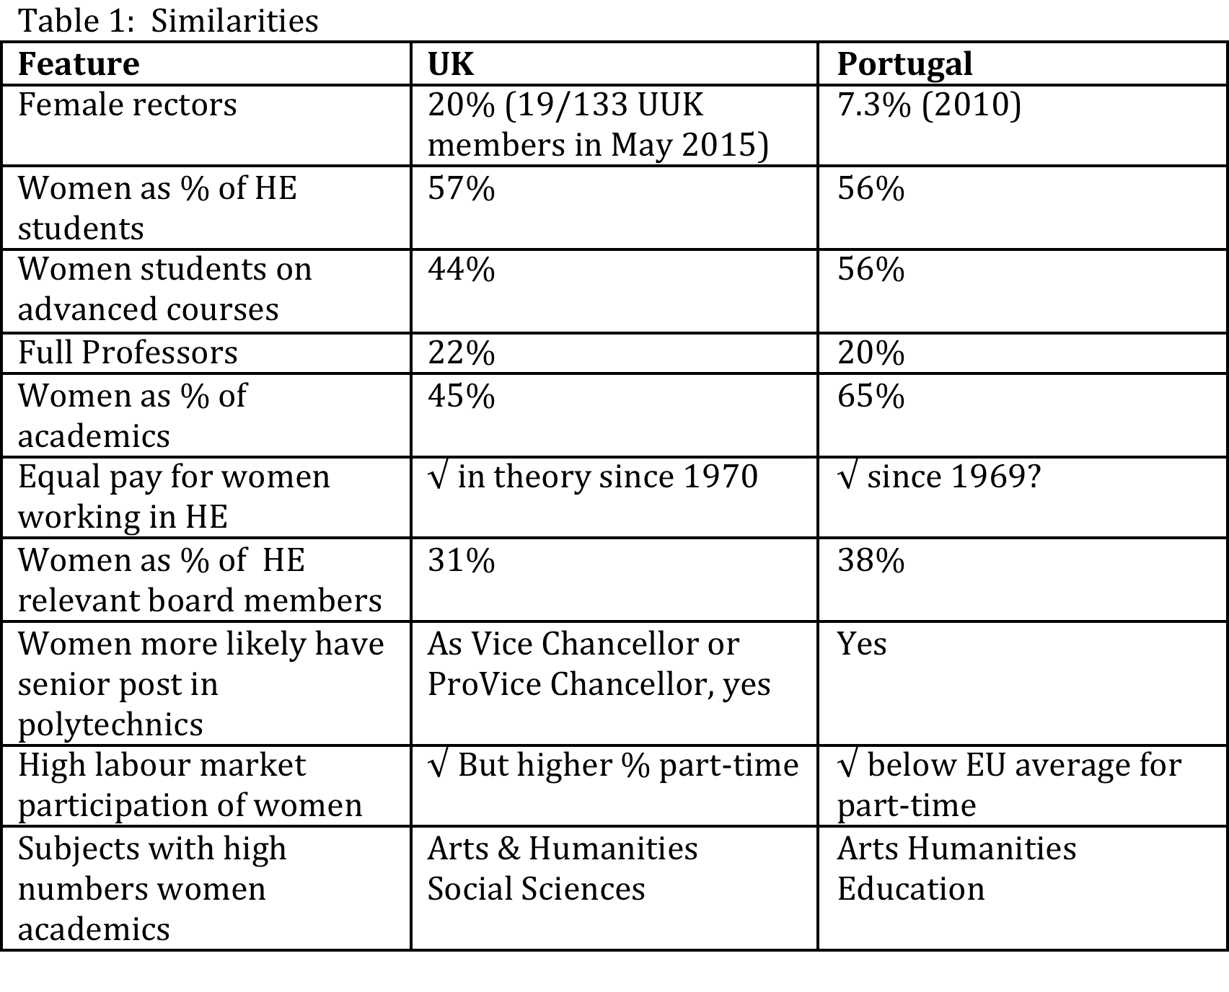
UK & Portugal: similarities

Slide 15
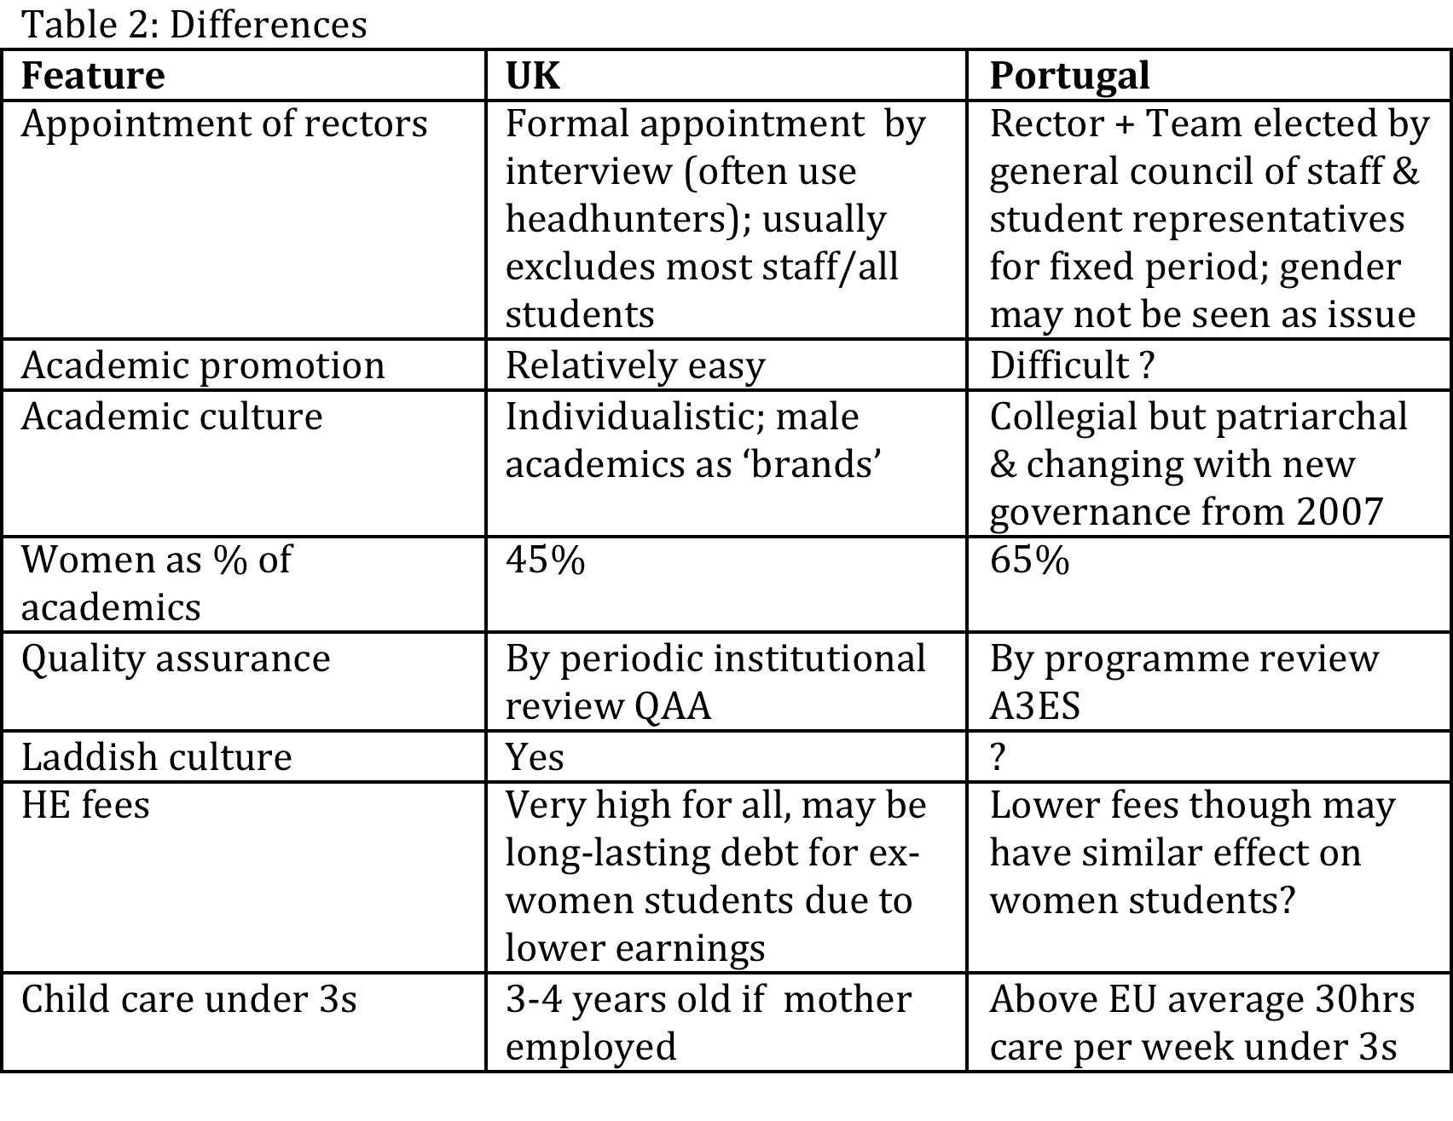
UK and Portugal: differences

Slide 16
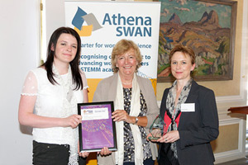
Women academics overcoming gender inequality

Slide 17
Doing more with less; gendered divisions of academic & administrative labour
If workloads go up, women academics may find themselves doing more of the pastoral care, teaching and good citizenship than men (Acker & Armenti 2004)
Female administrators may end up covering for those who leave & looking after students if some academics opt out; admin jobs are already in a third hybrid space between academic and administrative (Whitchurch 2013)

Slide 18
The student curriculum
How much are equality & diversity taken into account in curriculum development?
What are the mechanisms for ensuring this happens?
Shouldn’t quality and inequality be closely linked?
Who checks that the curriculum refers to equality & diversity? Who even cares?
Do we know & record student responses to issues of equality & diversity in the curriculum?
Is there a gendered response to evaluating teaching excellence?

Slide 19
‘Lad’ culture & laddishness
Phipps, Young, Buchanan Smith 2012
Contemporary laddism is based on drinking, football and sex; a hedonistic culture based on homosocial bonding, objectifying & sexually vilifying women
It includes initiation ceremonies, parties which exploit & mock women’s sexuality, male students offering women lifts home after nights out, but leaving them stranded
Also found in ‘lad’ websites & student sport societies
It stops women & men developing a shared culture based on respect & equality & fear of social media exposure & worse may prevent female students from seeking help; it may alienate gays, lesbians and transexuals too

Slide 20
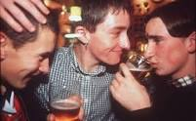
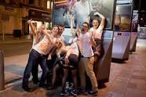
LADDISH CULTURE IS ALIVE & WELL IN UNIVERSITIES
LADDISH BEHAVIOUR: WHO IS QUESTIONING IT?

Slide 21
Laddishness in the lecture room
Jackson, Dempster,Pollard (2015)
Studied sport science students in former UK polytechnics
Found laddish behaviour such as loud talking & joking in class; throwing things, arriving late; being rude to lecturers.
Mature students often found these behaviours upsetting & it affected their learning
Other students also found such behaviour annoying and disruptive

Slide 22
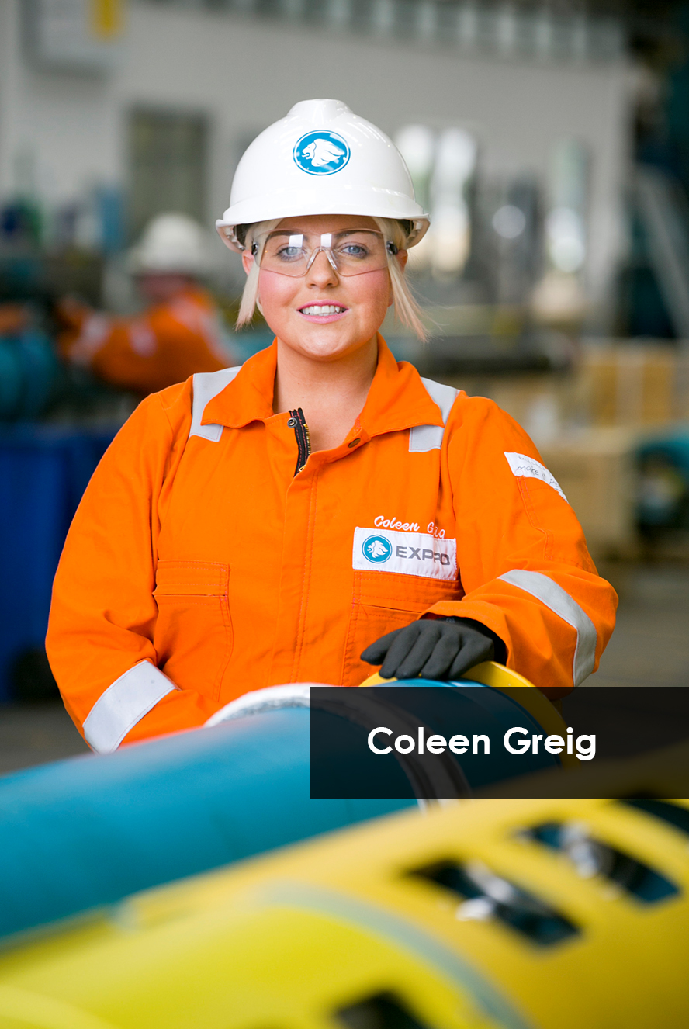


Women graduates & careers

Slide 23
Student futures in conditions of austerity
The HE achievements of women are less visible in the labour market, where they are not rewarded for their academic success (David 2014, Tiorres 2008)
But when men do much less domestic and caring worki (Torres, A., Coelho, B., Cardoso, I., and Brites, R. 2012) women still struggle to balance home and employment
Add all this to caring responsibilities in the home, made more extensive by public spending cuts to health and welfare, this means women’s futures are not as bright as their numerical dominance in HE and university achievements suggest

Slide 24

What’s changed??
New austerity regimes?
New

Slide 25
Are we going backwards?
Many of the problems of the gendered university under austerity conditions are not new but are made worse by spending cuts, weak labour markets, student individuation, academic egos and corporate universities who are oblivious to inequality
Gender equality in HE is still far from being accomplished & what is there is undermined by continuing inequality in household divisions of labour
Austerity can be an excuse for ignoring inequality
Unless we make an effort to challenge sexist practices & behaviours inside & outside HE & encourage women to take on leadership positions, nothing will change
A menos que façamos um esforço para desafiar práticas e comportamentos sexistas e incentivar as mulheres a assumir posições de liderança em universidades nada vai mudar

